Slide 1


Slide 2



HOUSING MARKET ANALYSIS
CIS 5560 – Term Project
Christian Ahamba
Sirisha Mahesh
Solange Ruiz
Damian Wilson
Instructor: Dr. Jongwook Woo

Slide 3

Introduction
The housing market plays a critical role in shaping major financial decisions. To better understand its trends, we analyze a 8.5GB dataset alongside real-time data from Redfin. Using Spark ML and scalable pipelines, we forecast price trends through regression, classify buyer behavior, and generate insights to support buyers, investors, and policymakers.

Slide 4

Originality
Unique Aspects of Our Project
Combines historical (10+ years) and near real-time housing data.
Focuses on both price forecasting and consumer behavior modeling.
Integrates external Redfin data with public datasets for deeper insights.

Slide 5

Data Overview
DATA SOURCE URLS
Source: Kaggle – Redfin Housing Market Data
Size: Over 8.5 GB
File Format: TSV
Scope: 10 years of property transactions
Features: Prices, locations, home characteristics
🔗 Kaggle Dataset
county_market_tracker.csv (363 MB)
neighborhood_market_tracker.csv (4.7 GB)
state_market_tracker.csv (20 MB)
us_national_market_tracker.csv (983 KB)
zip_code_market_tracker.csv (2.8 GB)
Notes:
We used the Redfin Housing Market dataset from Kaggle, which includes over 7 gigabytes of data covering 10 years of home sales.
The files include data at different levels — like county, zip code, and state.

Slide 6
DATA SOURCE URLS
DATA SET URL (8.5 GB)
https://www.kaggle.com/datasets/thuynyle/redfin-housing-market-data
GITHUB URL
https://github.com/sirishavivek2
Notes:
We used the Redfin Housing Market dataset from Kaggle, which includes over 7 gigabytes of data covering 10 years of home sales.
The files include data at different levels — like county, zip code, and state.

Slide 7




Hardware & Experimental Specifications

Slide 8
HARDWARE
Platform 1: Databricks Community Edition
Cluster Type: Community Optimized Instance
Driver Node:
Memory: 15.3 GB RAM
CPU: 2 cores
Storage: Databricks File System (DBFS)

Slide 9
HARDWARE
Platform 2: Remote HDFS Server (via SSH 144.24.13.0)
Server Type: Linux-based server
Processing Engine: Apache Spark to distribute data processing
Storage System: Hadoop Distributed File System (HDFS) Access Method: Git Bash terminal
Job Execution: Spark-submit CLI jobs

Slide 10
Experimental Specifications
Environments Used:
Databricks Community Edition
Databricks Runtime 12.2 LTS (Apache Spark 3.3.2, Scala 2.12)
Remote Linux Server (via SSH 144.24.13.0)
Apache Spark (standalone)
Hadoop Distributed File System (HDFS)

Slide 11
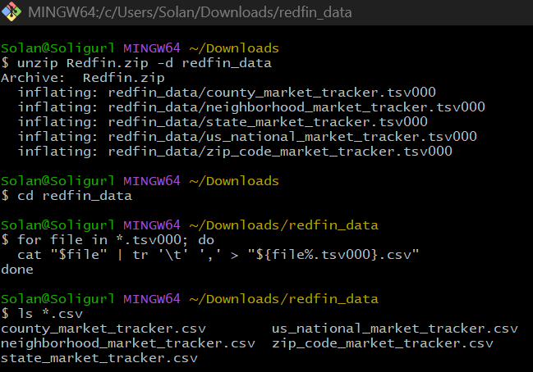
EXPERIMENTAL SPECIFICATIONS
Data Workflow:
Converted .TSV to .CSV
Transfer files to HDFS server
Upload CSV files to Databricks
Run Spark jobs

Slide 12
ADVANTAGES OF PREDICTING HOUSING MARKET ANALYSIS
Better Investment Decisions: Helps investors identify profitable opportunities and avoid risky markets.
Risk Management: Reduces exposure to market crashes and mortgage defaults.
Smarter Urban Planning: Assists governments in planning infrastructure and housing supply effectively.
Policy & Financial Insights: Supports data-driven policymaking and improves loan risk assessments for banks.

Slide 13
Project Scope
Predict housing market trends using historical data and machine learning techniques.
Data Cleaning and Feature Engineering
Use Hyper-parameters and parameters tuning.
Use Cross Validation and Train ValidationSplit to improve model performance
Comparing the difference between four Regression Models
Check models for overfitting.

Slide 14
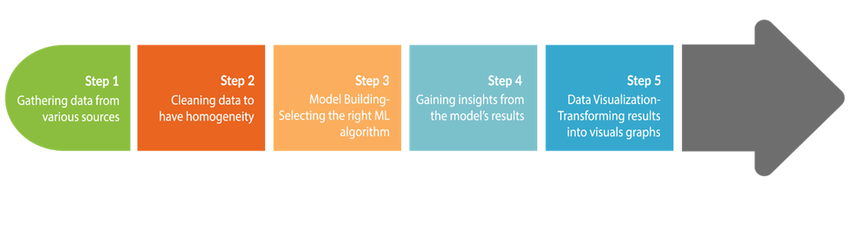
The Machine Learning Process

Slide 15
Architecture Workflow
Problem Definition
Data Collection
Data Preprocessing/ Exploration
Feature Engineering
Model Selection
Model Training
Model Evaluation
Model Tuning
Model Deployment

Slide 16
Related Work - 1
"Predicting Housing Prices and Analyzing Real Estate Market in the Chicago Suburbs Using Machine Learning" by Kevin Xu and Hieu Nguyen (2022)
Summary: This study analyzes the housing price predictions in the Chicago suburbs, utilizing machine learning models such as linear regression, support vector regression, decision tree regression, random forest regression, and XGBoost regression. The researchers collected sales data from Redfin, covering the period from 2018 to the summer of 2022, to analyze market trends and model performance. Their findings indicate that the XGBoost model outperforms others in predicting house prices, even amidst post-pandemic market volatility.
URL: https://www.jsr.org/hs/index.php/path/article/view/3459

Slide 17
Related Work -2
"An Optimal House Price Prediction Algorithm: XGBoost" by Hemlata Sharma, Hitesh Harsora, and Bayode Ogunleye (2024)
Summary: This research addressed housing price predictions by use of comparing various machine learning techniques, including support vector regressor, random forest regressor, XGBoost, multilayer perceptron, and multiple linear regression. Utilizing the Ames City housing dataset from Iowa, the study illustrates key factors such as influencing housing costs. These results demonstrates that XGBoost is the best-performing model for house price prediction, highlighting its effectiveness in capturing complex relationships within the data.
URL: https://arxiv.org/abs/2402.04082

Slide 18
Related Work - 3
"Housing Market Prediction Problem Using Different Machine Learning Algorithms: A Case Study" by Shashi Bhushan Jha et al. (2020)
Summary: This paper explores the development of accurate prediction models for housing prices using various machine learning algorithms, including XGBoost, CatBoost, Random Forest, Lasso, and Voting Regressor. The study utilizes a dataset of 62,723 records from Florida's Volusia County, spanning January 2015 to November 2019. By comparing model performances based on metrics like R², MSE, MAE, and computational time, the research concludes that the XGBoost algorithm outperforms others in predicting housing prices.
URL: https://arxiv.org/abs/2006.10092

Slide 19
Related Work- Our Project Reflection
Our project distinguishes itself through several key aspects. Incorporating real-time data from Redfin, capturing the most current market trends, and enhancing the relevance and timeliness of insights.
Since the other studies primarily predict average housing prices, our project emphasizes price volatility providing a more adequate understanding of market dynamics. Utilizing Apache Spark's distributed computing capabilities allowed our project to efficiently process and analyze a 7GB+ dataset, demonstrating the framework's scalability in handling large volumes of data.
In conclusion, our Apache Spark-based approach offers a comprehensive and scalable framework for analyzing housing price volatility, setting it apart from the other studies that may not have integrated real-time data or focus on these critical market indicators.

Slide 20
Spark ML Algorithms Used
Linear Regression
Rationale:
It's a good baseline model that assumes a linear relationship between features (e.g. homes sold, new listings) and the target (median list price). It is fast to train and interpret.
Random Forest Regression
Rationale:
An ensemble of decision trees that reduces overfitting by averaging the predictions of many trees.
It is more robust and can handle missing data and feature importance.

Slide 21
Spark ML Algorithms Used
Decision Tree
Rationale:
It captures non-linear relationships and interactions between features by splitting the data recursively. It is easy to visualize and interpret and can handle both numerical and categorical data as well.
Gradient Boosting Tree
Rationale:
Build trees sequentially, each one trying to correct the errors of the previous one.
Typically gives the best performance for structured/tabular data like the Redfin Housing Market.

Slide 22
Model Implementation
Screenshots
Training, Testing methods
Use of Cross-Validator, TrainValidationSplit, Feature Importance

Slide 23
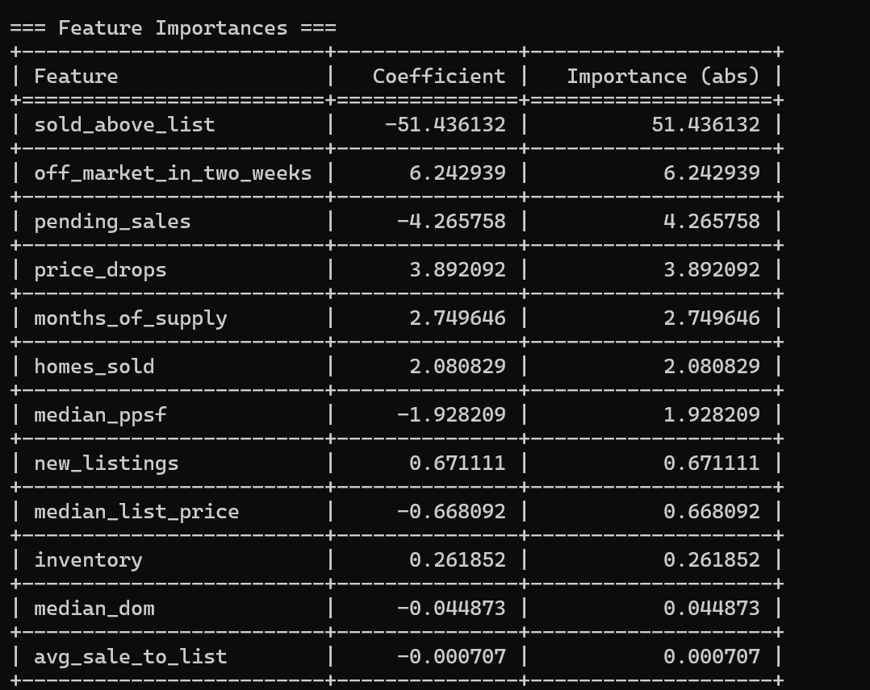
Feature Importance of Linear Regression

Slide 24
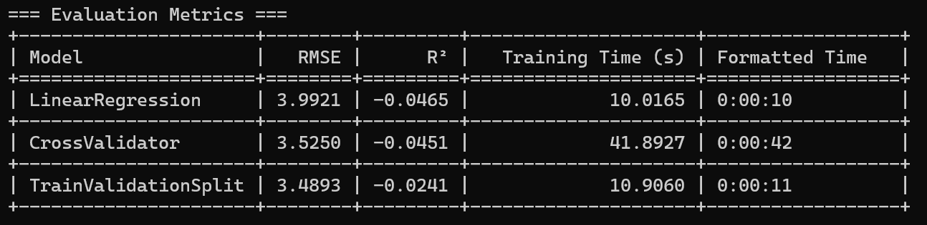
Results and Metrics &Computation Time Using Linear Regression

Slide 25
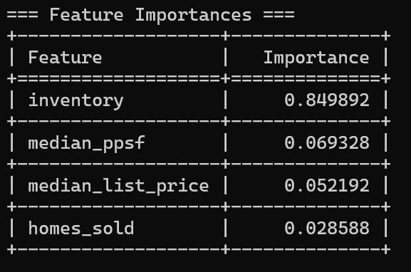
Feature Importance of Random Forest Regression

Slide 26
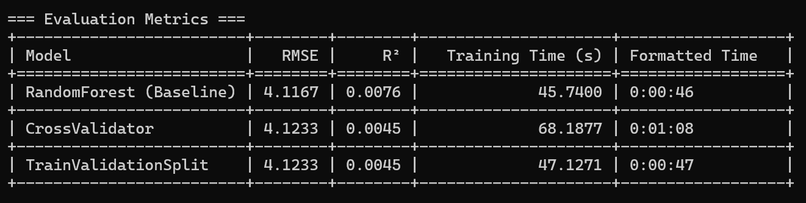
Result and Matrix & Computation Time using Random Forest Regression

Slide 27
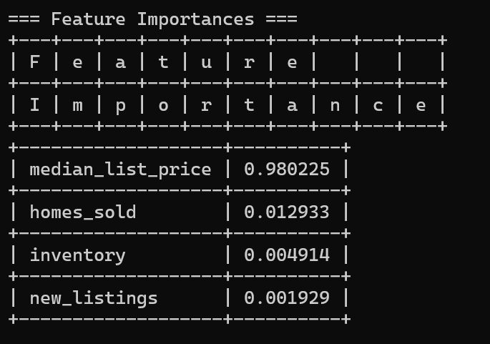
Feature Importance of Decision Trees

Slide 28
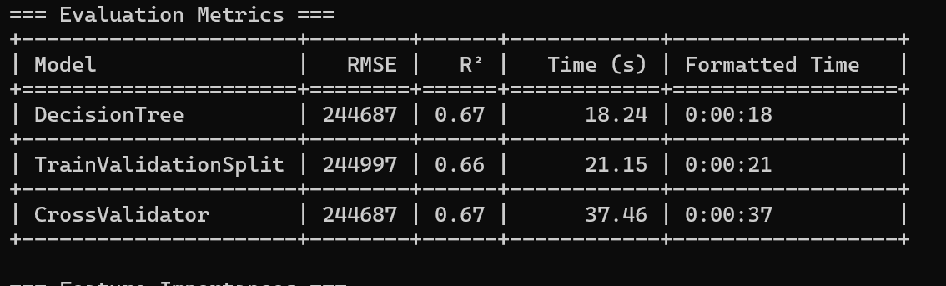
Result Matrix & Computation Time Using Decision Tree

Slide 29
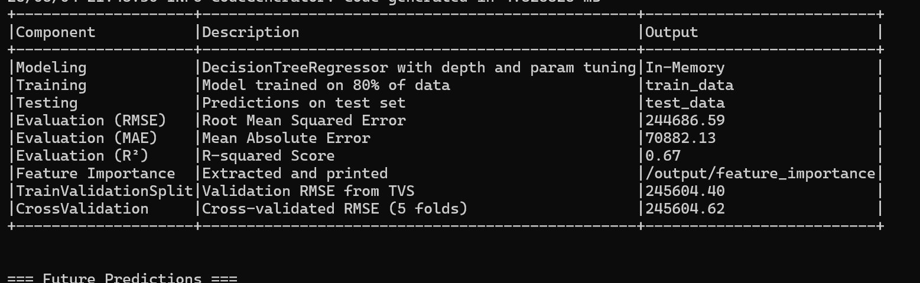
Results and Metrics Using Decision Trees

Slide 30
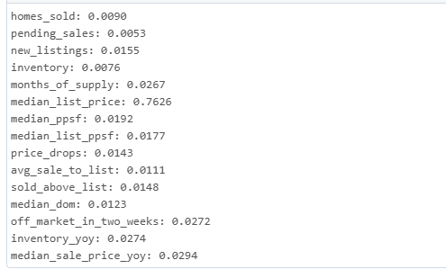
Feature Importance of Gradient Boosting

Slide 31
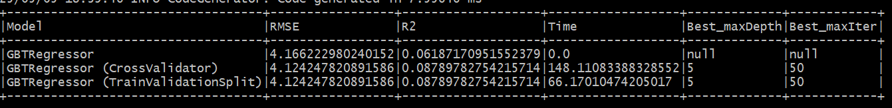
Results Metrics & Computation Times using Gradient Boosting

Slide 32
Comparing Models Base Models
Model Name | RMSE | R2 | Time
Linear Regression | 3.9921 | -0.0465 | 10.0165 sec
Random Regression | 4.1167 | 0.0076 | 45.7400 sec
Decision Tree | 244687 | 0.67 | 18.24 sec
GBT Regression | 4.166222 | 0.0618717 | 0.0 Sec

Slide 33
Comparing Models Regression TVS
Model Name | RMSE | R2 | Time
Linear Regression - TVS | 3.4893 | -0.0241 | 10.9060 sec
Random Regression- TVS | 4.1233 | 0.0045 | 47.1271 sec
Decision Tree - TVS | 244997 | 0.66 | 21.15 sec
GBT Regression - TVS | 4.124247 | 0.0878978 | 66.1701042 sec

Slide 34
Comparing Models Regression CV
Model Name | RMSE | R2 | Time
Linear Regression - CV | 3.5250 | -0.0451 | 41.8927 sec
Random Regression- CV | 4.1233 | 0.0045 | 68.1877 sec
Decision Tree - CV | 244687 | 0.67 | 37.46 sec
GBT Regression - CV | 4.12424 | 0.0878978 | 148.1108833 sec

Slide 35
Summary of findings
The results from Linear Regression shows a poor fit, as R2 is negative. With the TrainValidationSplit, there was a slight improvement but still poor fit. CrossValidating shows heavier tuning but still underperforms.
The results from Random Forest has a slightly better R2 than Linear Regression.TrainValidationSplit gives a lower R2 than the base.
With CrossValidation, there is no gain from tuning.

Slide 36
Summary of findings
The results from Decision Tree has a high R2 but massive RMSE (unit scale). Decision Tree TrainValidationSplit gives a similar performance. CrossValidating shows consistency with others.
The results from Gradient Boosted Tree shows a reasonable R2 with fast training. Gradient Boost TrainValidationSplit has the best R2 among other GBTs. CrossValidating shows same score but much longer training.

Slide 37
Recommendations
GBT is the best model overall, balancing performance and RMSE.
Decision Trees show promise, but need preprocessing (e.g. normalization, scaling) to manage RMSE magnitude.
Linear and Random Forest models should likely be discarded unless more features or transformation are introduced.
Cross-validation added little benefit in most cases – TrainValidationSplit was faster and yielded equivalent result.

Slide 38
Challenges
Understanding the big dataset
Understanding the feature and their meaning
Handling null values
Cleaning a large amount of data
Frequent Parameter tuning to achieve high accuracy

Slide 39
References
Github Link: https://github.com/sirishavivek2/CIS5560
Data Source: https://www.kaggle.com/datasets/thuynyle/redfin-housing-market-data
Naeem, Nida, Irfan Ahmad Rana, and Abdur Rehman Nasir. Digital Real Estate: A Review of the Technologies and Tools Transforming the Industry and Society. Publisher, Year.
Letdin, Mariya, Dustin Read, and Spenser Robinson. "Similarities, Differences, and Best Practices Across Real Estate Education Programs in the United States." Journal of Real Estate Practice and Education

Slide 40

Questions?

Slide 41

THANK YOU!
https://github.com/sirishavivek2

